Slide 1
PHP
By Rahul Shrivastava

Slide 2
Introduction
PHP is a server scripting language, and a powerful tool for making dynamic and interactive Web pages.

Slide 3
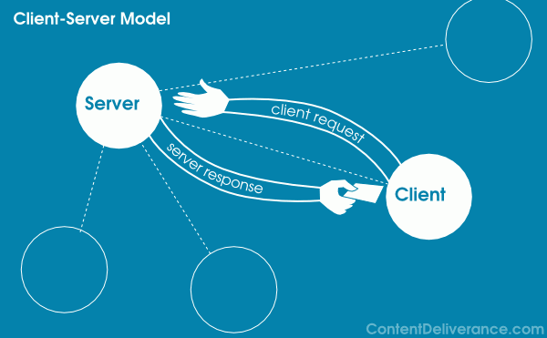
Terminology

Slide 4
PHP Script
<? php
try code here
?>

Slide 5
PHP Variable
A variable starts with the $ sign, followed by the name of the variable
A variable name must start with a letter or the underscore character
A variable name cannot start with a number
A variable name can only contain alpha-numeric characters and underscores (A-z, 0-9, and _ )
Variable names are case-sensitive ($age and $AGE are two different variables)

Slide 6
Variable Scope
In PHP, variables can be declared anywhere in the script.
The scope of a variable is the part of the script where the variable can be referenced/used.
PHP has three different variable scopes:
local
global
static

Slide 7
Global and Local Scope
<?php $x = 5; // global scope function myTest() { // using x inside this function will generate an error echo "<p>Variable x inside function is: $x</p>"; } myTest(); echo "<p>Variable x outside function is: $x</p>"; ?>

Slide 8
<?php $x = 5; $y = 10; function myTest() { global $x, $y; $y = $x + $y; } myTest(); echo $y; // outputs 15 ?>

Slide 9
<?php $x = 5; $y = 10; function myTest() { $GLOBALS['y'] = $GLOBALS['x'] + $GLOBALS['y']; } myTest(); echo $y; // outputs 15 ?>

Slide 10
<?php $x = 5; $y = 10; function myTest() { global $x, $y; $y = $x + $y; } myTest(); echo $y; // outputs 15 ?>

Slide 11
<?php function myTest() { static $x = 0; echo $x; $x++; } myTest(); myTest(); myTest(); ?>

Slide 12
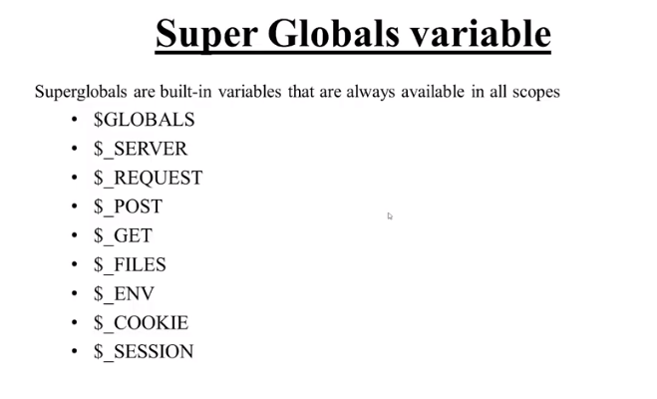

Slide 13
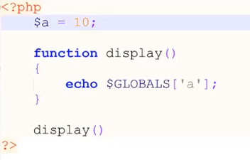
$GLOBAL

Slide 14
PHP Data Types
Variables can store data of different types, and different data types can do different things.
PHP supports the following data types:
String
Integer
Float (floating point numbers - also called double)
Boolean
Array
Object
NULL
Resource

Slide 15
<!DOCTYPE html>
<html>
<body>
<?php
$x = 10.365;
var_dump($x);
?>
</body>
</html>

Slide 16
Array
<?php $cars = array("Volvo","BMW","Toyota"); var_dump($cars); ?>
<?php $cars = array("Volvo", "BMW", "Toyota"); echo "I like " . $cars[0] . ", " . $cars[1] . " and " . $cars[2] . "."; ?>

Slide 17
Multi-dimension Array
$cars = array ( array("Volvo",22,18), array("BMW",15,13), array("Saab",5,2), array("Land Rover",17,15) );
<?php echo $cars[0][0].": In stock: ".$cars[0][1].", sold: ".$cars[0][2].".<br>"; echo $cars[1][0].": In stock: ".$cars[1][1].", sold: ".$cars[1][2].".<br>"; echo $cars[2][0].": In stock: ".$cars[2][1].", sold: ".$cars[2][2].".<br>"; echo $cars[3][0].": In stock: ".$cars[3][1].", sold: ".$cars[3][2].".<br>"; ?>

Slide 18
SORT in ARRAY
<html>
<body>
<?php
$cars = array("Volvo", "BMW", "Toyota");
sort($cars);
$clength = count($cars);
for($x = 0; $x < $clength; $x++) {
echo $cars[$x];
echo "<br>";
}
?>

Slide 19
<?php class Car { public $color; public $model; public function __construct($color, $model) { $this->color = $color; $this->model = $model; } public function message() { return "My car is a " . $this->color . " " . $this->model . "!"; } } $myCar = new Car("black", "Volvo"); echo $myCar -> message(); echo "<br>"; $myCar = new Car("red", "Toyota"); echo $myCar -> message(); ?>

Slide 20
<?php
class Employee
{
Public $name;
Public $position;
function __construct($name,$position)
{
// This is initializing the class properties
$this->name=$name;
$this->profile=$position;
}
function show_details()
{
echo $this->name." : ";
echo "Your position is ".$this->profile."\n";
}
}
$employee_obj= new Employee("Rakesh","developer");
$employee_obj->show_details();
$employee2= new Employee("Vikas","Manager");
$employee2->show_details();
?>

Slide 21
Advantages of using Constructors:
Constructors provides the ability to pass parameters which are helpful in automatic initialization of the member variables during creation time .
The Constructors can have as many parameters as required and they can be defined with the default arguments.
They encourage re-usability avoiding re-initializing whenever instance of the class is created .
You can start session in constructor method so that you don’t have to start in all the functions everytime.
They can call class member methods and functions.
They can call other Constructors even from Parent class.

Slide 22
IF ELSE
<?php $t = date("H"); if ($t < "20") { echo "Have a good day!"; } ?>

Slide 23
Switch
<?php $favcolor = "red"; switch ($favcolor) { case "red": echo "Your favorite color is red!"; break; case "blue": echo "Your favorite color is blue!"; break; case "green": echo "Your favorite color is green!"; break; default: echo "Your favorite color is neither red, blue, nor green!"; } ?>

Slide 24
While
<?php $x = 1; while($x <= 5) { echo "The number is: $x <br>"; $x++; } ?>

Slide 25
FOR EACH
<?php $colors = array("red", "green", "blue", "yellow"); foreach ($colors as $value) { echo "$value <br>"; } ?>

Slide 26
Function
<?php function writeMsg() { echo "Hello world!"; } writeMsg(); // call the function ?>

Slide 27

Form
<html> <body> <form action="welcome.php" method="post"> Name: <input type="text" name="name"><br> E-mail: <input type="text" name="email"><br> <input type="submit"> </form> </body> </html>

Slide 28

Form Processing
<html> <body> Welcome <?php echo $_POST["name"]; ?><br> Your email address is: <?php echo $_POST["email"]; ?> </body> </html>

Slide 29
Form
<html> <body> <form action="welcome_get.php" method="get"> Name: <input type="text" name="name"><br> E-mail: <input type="text" name="email"><br> <input type="submit"> </form> </body> </html>

Slide 30
Form processing using GET
<html> <body> Welcome <?php echo $_GET["name"]; ?><br> Your email address is: <?php echo $_GET["email"]; ?> </body> </html>

Slide 31
When to use GET?
Information sent from a form with the GET method is visible to everyone (all variable names and values are displayed in the URL). GET also has limits on the amount of information to send. The limitation is about 2000 characters. However, because the variables are displayed in the URL, it is possible to bookmark the page. This can be useful in some cases.
GET may be used for sending non-sensitive data.

Slide 32
When to use POST?
Information sent from a form with the POST method is invisible to others (all names/values are embedded within the body of the HTTP request) and has no limits on the amount of information to send.
Moreover POST supports advanced functionality such as support for multi-part binary input while uploading files to server.
However, because the variables are not displayed in the URL, it is not possible to bookmark the page.

Slide 33
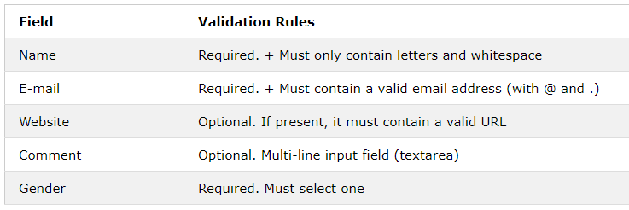
PHP Validation

Slide 34
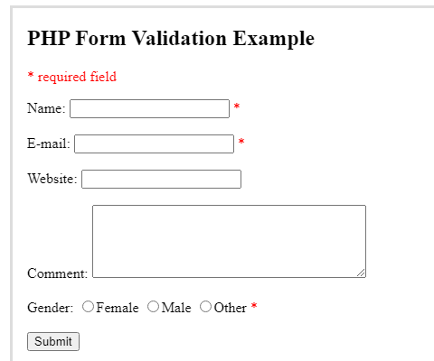

Slide 35
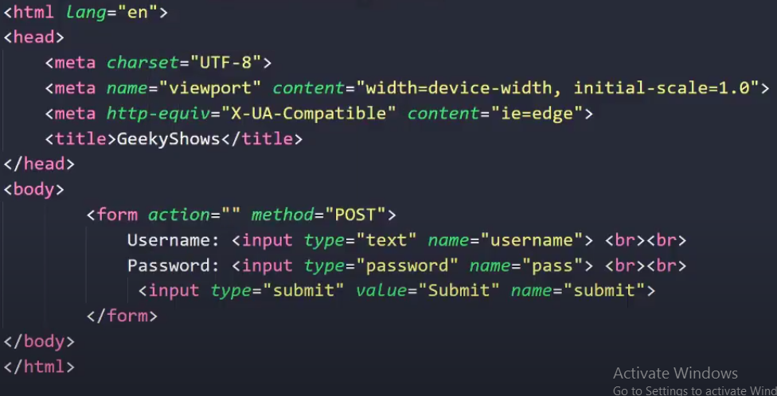

Slide 36
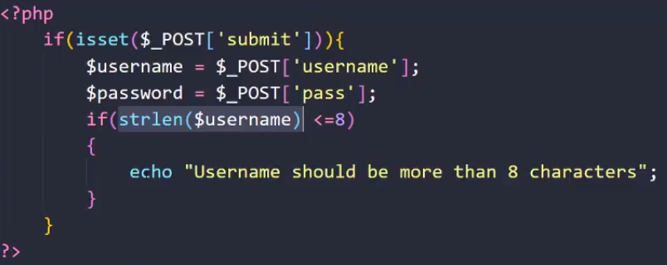
Form Validation

Slide 37
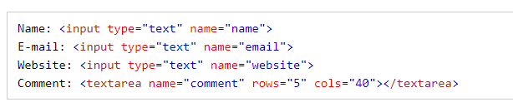
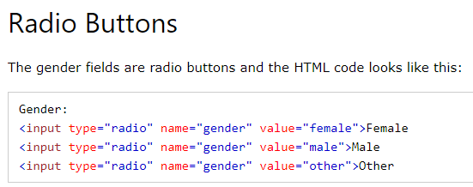
Text Fields

Slide 38

